Slide 1
Redeemer
Earthquake Rescue Robot
Anthia Ma
Watcher Wang

Slide 2
Robot Design
Platform-like structure allows robot to easily carry supplies
Yellow: Sensors used for seeking light and spotting obstacles
Mechanical arm (shovel) used for moving objects
Pink: Arduino controller
Red: Joints fixed on robot
Black: Motor
Orange: Battery
Multiple legs enable moving on complicated terrain

Slide 3
Mechanics
Piston-like structure allows full movements (forward, back, turning) with 6 legs, controlled by only 2 motors

Slide 4
Mechanics
1
2
3
4

Slide 5
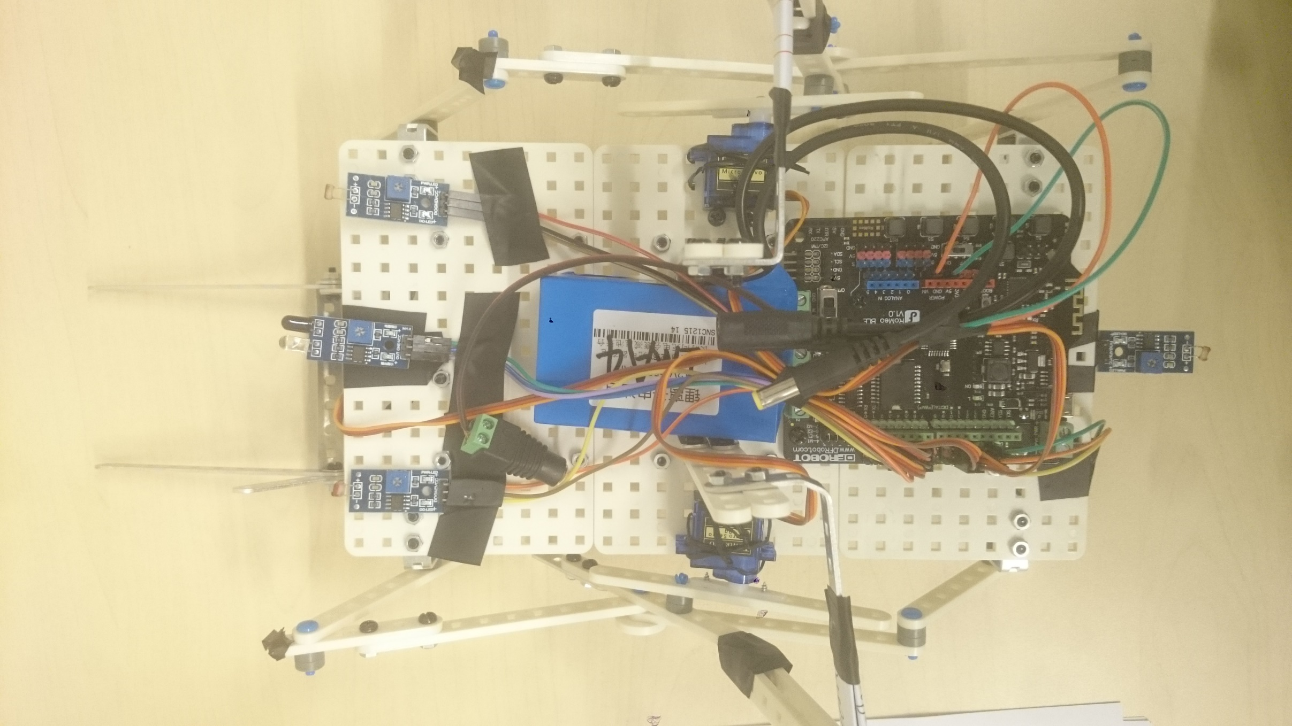
Electronics
Motors for legs:
Left: pin 9
Right: pin 10
Sensor:
Back: pin 12
(light)
Motor for arm (shovel): pin 4
Sensors:
Front: pin 2, 3, 5 (light and infrared)

Slide 6
Functionality
Robot can follow the guide of light signal to move forward

Slide 7
Functionality
Robot can follow the guide of light signal to turn accordingly

Slide 8
Functionality
Robot can follow the guide of light signal to turn accordingly

Slide 9
Functionality
Crawler structure allows movement on different types of terrains

Slide 10
Functionality
Platform-like structure allows robot to carry and transport rescue supplies

Slide 11
Functionality
!
Automatic obstacle detection with infrared sensor

Slide 12
Functionality
Automatic obstacle removal with shovel after detection

Slide 13
FSN Chart
Start
Clean Obstacle
Initialize
Obstacle at front
Turn Left
Idle
Finish cleaning
Light on left
Forward
Turn Right
No obstacle in sight
No light
Light on both sides
Move Back
Light on right
Seek Light
Light at back

Slide 14
Thank You!

